Slide 1
Empirical Investigation
Chapter 4

Slide 2
Empirical SE
Fill the gap between research and practice by:
Developing methods for studying SE practice
Building a body of knowledge of SE practice
Validating research before deployment in industrial settings

Slide 3
SE Investigation
What is software engineering investigation?
Applying “scientific” principles and techniques to investigate properties of software and software related tools and techniques.

Slide 4
SE Investigation: Example
Experiment to confirm rules-of-thumb
Should the LOC in a module be less than 200?
Should the number of branches in any functional decomposition be less than 7?
Experiment to explore relationships
How does the project team experience with the application affect the quality of the code?
How does the requirements quality affect the productivity of the designer?
How does the design structure affect maintainability of the code?
Experiment to initiate novel practices
Would it be better to start OO design with UML?
Would the use of automate testing improve software quality?

Slide 5
SE Investigation: Why?
To understand (a scenario, a situation)
To evaluate (process and/or product)
To improve (process and/or product)
To compare (entities, properties, etc.)
To prove a theory or hypothesis
To disprove a theory or hypothesis

Slide 6
SE Investigation: What?
Person’s /Team performance
Tool’s performance
Tool’s usability
Document’s understandability
Program’s complexity
etc.

Slide 7
SE Investigation: Where & When?
In the field
In the lab
In the classroom
Anytime depending on what questions you are asking

Slide 8
SE Investigation: How?
Hypothesis/question generation
Data collection
Data evaluation
Data interpretation
Feedback into iterative process

Slide 9
SE Investigation: Characteristics
Data sources come from industrial settings
This may include people, program code, etc.
Usually
Surveys
Case-studies (🡪 hypothesis generation)
Experiments (🡪hypothesis testing)

Slide 10
Where Data Come From?
Lethbridge, Sim, and Singer identify many factors that can affect the reliability of collected data (Lethbridge et al. 2005).
One factor to consider is the closeness of the connection between the evaluators or researchers and the software developers that are part of a project being studied.
The relative closeness of the connection is classified as
first degree,
second degree, or
third degree

Slide 11
Where Data Come From?
First degree:
Evaluators or researchers directly interact with developers. They may interview developers, observe them working, or otherwise interact directly with developers in their daily activities.
Second degree:
Evaluators or researchers indirectly interact with developers. They may instrument software development tools to collect information or may record meetings or other development activities.
Third degree:
Evaluators have no interactions with developers. Rather, they study artifacts such as revision control system records, fault reports and responses, testing records, etc. Third-degree studies can be performed retrospectively

Slide 12
Where Data Come From?
First Degree Contact
Direct access to participants
Example:
Brainstorming
Interviews
Questionnaires
Work diaries
Participant observation
Notes:
https://keydifferences.com/difference-between-questionnaire-and-interview.html

Slide 13
Where Data Come From?
Second Degree Contact
Access to work environment during work time, but not necessarily participants
Example:
Instrumenting systems
Real time monitoring

Slide 14
Where Data Come From?
Third Degree Contact
Access to work artifacts, such as source code, documentation
Example:
Problem report analysis
Documentation analysis
Analysis of tool logs
Off-line monitoring

Slide 15
Practical Considerations
Hidden Aspects of Performing Studies
Negotiations with industrial partners
Obtaining ethics approval and informed consent from participants
Adapting “ideal” research designs to fit with reality
Dealing with the unexpected
Staffing of project

Slide 16
Investigation Principles
There are 4 main principles of investigation:
Stating the hypothesis: What should be investigated?
Selecting investigation technique: conducting surveys, case studies, formal experiments
Maintaining control over variables: dependent and independent variables
Making meaningful investigation: verification of theories, evaluating accuracy of models, validating measurement results.

Slide 17
PRINCIPLES OF EMPIRICAL STUDIES
The key principles involved in designing empirical studies
The level of control of study variables that determines the appropriate type of study
Study goals and hypotheses
Maintaining control of variables
Threats to validity
The use of human subjects

Slide 18
Investigation Techniques
Three ways to investigate:
Formal experiment: A controlled investigation of an activity, by identifying, manipulating and documenting key factors of that activity.
Case study: Document an activity by identifying key factors (inputs, constraints and resources) that may affect the outcomes of that activity.
Survey: A retrospective study of a situation to try to document relationships and outcomes.

Slide 19
Example
Experiment: research in the small
You have heard about scrum and its advantages and may want to investigate whether to use scrum in your company. You may design a controlled (dummy) project and apply the scrum technique to it. You may want to experiment with the various aspects of scrum and document the results for further investigation.
To conduct a controlled experiment, you decide in advance what you want to investigate and then plan how to capture data to support your investigation.
a controlled experiment is a rigorous, controlled investigation of an activity, where the key factors are identified and manipulated to document their eﬀects on the outcome.

Slide 20
Example
Case study: research in the typical
You may have used scrum for the first time in a project in your company. After the project is completed, you may perform a case-study to capture the effort involved (budget, personnel), the number of failures investigated, and the project duration.
A case study is a quasi-experiment where you identify key factors that may aﬀect the outcome of an activity and then document the activity inputs, constraints, resources, and outputs.
Notes:
safety-critical systems may entail a high degree of risk in experimentation, and a case study may be more feasible.

Slide 21
Example
Survey: investigate in the large
After you have used scrum in many projects in your company, you may conduct a survey to capture the effort involved (budget, personnel), the number of failures investigated, and the project duration for all the projects. Then, you may compare these figures with those from projects using conventional software development to see if scrum could lead to an overall improvements in practice.
Surveys try to poll what is happening broadly over large groups of projects and are thus research in the large.

Slide 22
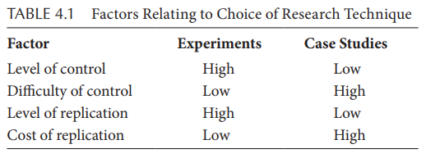
Case-study or Experiment?
How to decide whether conduct an experiment or perform a case-study?
Control is the key factor

Slide 23
Control of Variables and Study Type
Empirical studies that involve observations where potential confounding variables cannot be controlled and/or subjects cannot be assigned to treatment or control groups are called observational studies, natural experiments, and/or quasi-experiments.
Empirical studies in software engineering are case studies that involve the use of a tool or technique on projects without random assignment of subjects to projects and control of all other variables. Thus, these software engineering case studies are really quasi-experiments.

Slide 24
Control of Variables and Study Type
Controlled experiments tend to be conducted in academia or research labs. They are rarely conducted inside software development organizations because it is usually not possible to control all potential confounding factors. Application domains, environments, tools, processes, the capabilities of developers, and many other factors can vary widely and are hard to control.
A survey is a retrospective study of a situation to try to document relationships and outcomes. Thus, a survey is done after an event has occurred.

Slide 25
Hypothesis
The first step is deciding what to investigate.
The goal for the research can be expressed as a hypothesis in quantifiable terms that is to be tested.
The test result (the collected data) will confirm or refute the hypothesis.
Example: Does the Scrum method produce better quality software than using conventional waterfall model? or
If using the Scrum method produces better quality software than using the waterfall then code produced using Scrum will have fewer defects per thousand lines of code than code produced using the waterfall method.

Slide 26
Hypothesis Cont’d
Other Examples:
Can integrated development and testing tools improve our productivity?
Does code produced using Agile software development have a lower number of defects per KLOC than code produced using the conventional methods?

Slide 27
Hypothesis Cont’d
first evaluate a null hypothesis, which states that the proposed relationship does not hold.
Hyp0: There is no diﬀerence between the quality of software produced by the Scrum method and the quality of the software produced by using the XP method as indicated by defects per thousand lines of code.
After rejecting the null hypothesis, you can evaluate alternative hypotheses
HypA1: The code produced using Scrum will have fewer defects per thousand lines of code than the code produced using the XP method.
HypA2: The code produced using XP will have fewer defects per thousand lines of code than the code produced using the Scrum method.

Slide 28
Maintaining Control over Variables
What variables may affect truth of a hypothesis?
for each variable identified, you must decide how much control you have over it.
How do they affect it?
Variable:
Independent (values are set by the experiment or initial conditions)
Dependent (values are affected by change of other variables)
Example:
Effect of “programming language” on the “quality” of resulting code. Programming language is an independent and quality is a dependent variable.

Slide 29
Maintaining Control over Variables
The treatment of state variables diﬀers in case studies and controlled experiments.
A state variable is a factor that can characterize your project and inﬂuence your evaluation results. Sometimes, state variables are called independent variables, because they can be manipulated to aﬀect the outcome.
Examples of state variables include the application area, the system type, or the developers’ experience with the language, tool, or method.
Notes:
The treatment group (also called the experimental group) receives the treatment whose effect the researcher is interested in. The control group receives either no treatment, a standard treatment whose effect is already known, or a placebo (a fake treatment).
In a controlled experiment, you can identify the variables and sample over them.
This phrase means that you select projects exhibiting a variety of characteristics possible for your organization and design your research so that more than one value will be taken for each characteristic. You aim for coverage, so that you have an instance for each possibility or possible combination.
In a case study, you sample from the state variable, rather than over it
This phrase means that you select a value of the variable that is typical for your organization and its projects.

Slide 30
Maintaining Control over Variables
A common mistake: ignoring other variables that may affect the values of a dependent variable.
Example:
Suppose you want to determine whether a change in programming language (independent variable) can affect the productivity (dependent variable) of your project. For instance, you currently use FORTRAN and you want to investigate the effects of changing to Ada. The values of all other variables should stay the same (e.g., application experience, programming environment, type of problem, etc.)
Without this you cannot be sure that the difference in productivity is attributable to the change in language.
But list of other variables may grow beyond control!

Slide 31
Threats to Validity
We have all seen reports about studies with new results that contradict results reported from the past.
A new study might show that a medical treatment is not eﬀective, even though prior studies supported the eﬀectiveness of the treatment.
No study is perfect; there are many ways that a study can provide misleading results. Potential problems with empirical studies are classified as categories of threats to validity.
Conclusion validity
Construct validity

Slide 32
Threats to Validity
Conclusion validity: Conclusion validity refers to the statistical relationship between independent and dependent variables.
A study has conclusion validity if the results are statistically significant using appropriate statistical tests.
Treats to conclusion validity include using the wrong statistical tests, having too small a sample, and searching for relationships between too many variables, which increases the odds of finding a spurious correlation.
Construct validity. A study with construct validity uses measures that are relevant to the study and meaningful.
Using the measure faults per KLOC as a measure of code quality has some threats to validity since its value depends in part on when the measure is taken, for example, during testing (faults found during testing) or after release (faults found by customers).
The key is to use meaningful measures, that is, the measures give values that are consistent with our intuition about the attribute that they purport to quantify.

Slide 33
Threats to Validity
Internal validity. Internal validity refers to the cause–eﬀect relationship between independent and dependent variables.
A study has internal validity if the treatment actually caused the eﬀect shown in the dependent variables.
Specific threats include the eﬀects of other, possibly unidentified, variables. To have internal validity, there must be a causal theory—an a priori rationale for why the independent variable would aﬀect the dependent variable.
In addition, there should be temporal precedence between independent and dependent variables—measurements of independent variables must have been taken before the dependent variables are measured. Otherwise, instead of A causing B, B might cause A.

Slide 34
Threats to Validity
External validity. External validity refers to how well you can generalize from the results of one study to the wider world.
The ability to generalize depends on how similar the study environment is to the environment used in actual practice.
It depends on how similar the study subjects (i.e., undergraduate students, graduate students, novice, and experienced developers) are to software developers in practice.
A study results will tend to be more relevant to environments that are most similar to the study environment.

Slide 35
Human Subjects
Empirical studies in software engineering often make use of human subjects.
A survey may involve asking developers to respond to questions about their use of tools or other experiences.
A case study may involve the study of a programming team and their activities as they develop a product.
A controlled experiment may involve assigning students to treatment and control groups to evaluate a new technique.
Human subject means a living individual about whom an investigator (whether professional or student) conducting research obtains
Data through intervention or interaction with the individual
Identifiable private information

Slide 36
Human Subjects
Research involving human subjects meet specified standards
informed consent
privacy issues.
informed consent refers to a human subject who explicitly agrees to take part in a study after being informed of the nature of the study and the potential risks.
SE has major risks due to privacy issues.
For example, a subject’s reputation may be aﬀected by the public release of a subject’s participation as a member of the group with a higher defect rate.
The protections might include encrypting all identifying information and destroying identifying information when the study is released.

Slide 37
PLANNING EXPERIMENTS
Suppose you have decided that a controlled experiment is the best investigative technique for the questions you want to answer.
Controlled experiments (and case studies) need to be carried out in phases to ensure that all important issues and concerns are addressed and that the results will be useful.
A six-phase process:
Conception
Design
Preparation
Execution
Analysis
Dissemination and decision-making
it is a good idea to test your experimental design with a small pilot study, involving a small number of subjects before running a full-scale study.

Slide 38
Formal Experiments: process
Conception
Defining the goal of investigation
The conception stage includes analysis to ensure that a controlled experiment, case study, and/or survey are appropriate.
Design
Generating quantifiable (and manageable) hypotheses to be tested
Defining experimental objects or units, subject, variables
For example:
the effect of using the Python language on the quality of the resulting code.
You must ask specific questions, such as 1. How quality is to be measured? 2. How is the use of Python to be measured? 3. What are the factors that inﬂuence the characteristics to be analyzed? For example, will experience, tools, design techniques, or testing techniques make a difference? 4. Which of these factors will be studied in the investigation? 5. How many times should the experiment be performed, and under what conditions?

Slide 39
Formal Experiments: process
The new method or tool you wish to evaluate (compared with an existing or diﬀerent method or tool) is called the treatment.
Your experiment will consist of a series of tests of your methods or tools, and the experimental design describes how these tests will be organized and run. In any individual test run, only one treatment is used. An individual test of this sort is sometimes called a trial, and the experiment is formally defined as the set of trials.
The experimental objects or experimental units are the objects to which the treatment is being applied.
a development or maintenance project can be your experimental object, and aspects of the project’s process or organization can be changed to aﬀect the outcome. Or, the experimental objects can be programs or modules, and diﬀerent methods.

Slide 40
Formal Experiments: process
At the same time, you must identify who is applying the treatment; these people are called the experimental subjects. For example, programmer.
You must define independent (or state) variable, dependent (or response) variable. You also define control variables that do not have impact to response variable.
The more the subjects, objects, and variables, the more complex the experimental design becomes and often the more difficult the analysis.

Slide 41
Formal Experiments: process
Preparation
Preparation involves readying the subjects for application of the treatment.
Getting ready to start, e.g., purchasing tools, hardware, training personnel, etc.
Instructions must be written out or recorded properly. A pilot study—a dry run of the experiment on a small set of people—is very useful.
Execution
you conduct the experiment.
Following the steps laid out in the plan, and measuring attributes as prescribed by the plan, you apply the treatment to the experimental objects.
Review and analysis
Review the results for soundness and validity
Dissemination & decision making
Documenting conclusions
It allows to duplicate your experiment and confirm your conclusions in a similar setting.

Slide 42
Key Experimental Design Concepts
An experimental design deals with experimental units and experimental error.
an experimental unit is the experimental object to which a single treatment is applied.
Experimental error describes the failure of two identically treated experimental units to yield identical results. The error can reﬂect a host of problems:
Errors of experimentation.
Errors of observation.
Errors of measurement.
The variation in experimental resources.
The combined eﬀects of all extraneous factors that can inﬂuence the characteristics under study but which have not been singled out for attention in the investigation.
Notes:
An experimental design deals with experimental units and experimental error. As noted above, an experimental unit is the experimental object to which a single treatment is applied. Experimental error describes the failure of two identically treated experimental units to yield identical results.

Slide 43
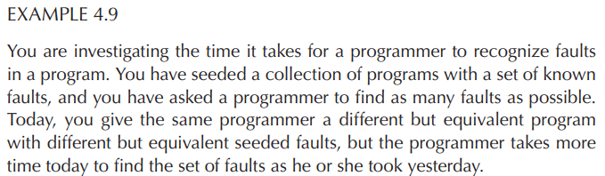
Key Experimental Design Concepts
The programmer’s mind wandered during the experiment.
The timer measured elapsed time inexactly.
The programmer was distracted by loud noises from another room.
The programmer found the faults in a diﬀerent sequence today than yesterday.
Faults that were thought to be equivalent are not.
Programs that were thought to be equivalent are not.

Slide 44
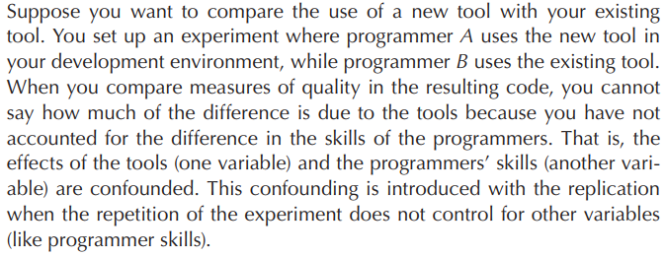
Key Experimental Design Concepts
The three key experimental design concepts—replication, randomization, and local control—address the problem of variability by giving us guidance on forming experimental units so as to minimize the experimental error.
Replication
Experiment under identical conditions should be repeatable.
Confounded results (unable to separate the results of two or more variables) should be avoided.
replication can help us to know how much confidence we can place in the results of the experiment.
Notes:
Two or more variables are confounded if it is impossible to separate their eﬀects when the subsequent analysis is performed.

Slide 45
Key Experimental Design Concepts
Randomization
The experimental trials must be organized in a way that the effects of uncontrolled variables are minimized.
For example, sometimes the results of an experimental trial can be aﬀected by the time, the place, or unknown characteristics of the participants.
To spread and diﬀuse the eﬀects of these uncontrollable or unknown factors, you can assign the order of trials randomly, assign the participants to each trial randomly, or assign the location of each trial randomly, whenever possible.
Suppose each of 30 programmers is trained to perform both testing (manual, automated) techniques. We can randomly assign 15 of the programmers to use technique X on a given program, and the remaining 15 can use technique Y on the same program.

Slide 46
Key Experimental Design Concepts
Local control
Blocking: allocating experimental units to blocks or groups so the units within a block are relatively homogeneous. The blocks are designed so that the experimental design captures the anticipated variation in the blocks by grouping like varieties, so that the variation does not contribute to the experimental error.
Balancing: is the blocking and assigning of treatments so that an equal number of subjects is assigned to each treatment. Balancing is desirable because it simplifies the statistical analysis.

Slide 47
Example: Blocking & Balancing
You are investigating the comparative effects of three design techniques on the quality of the resulting code.
The experiment involves teaching the techniques to 12 developers and measuring the number of defects found per 1000 LOC to assess the code quality.
It may be the case that the twelve developers graduated from three universities. It is possible that the universities trained the developers in very different ways, so that being from a particular university can affect the way in which the design technique is understood or used.
To eliminate this possibility, three blocks can be defined so that the first block contains all developers from university X, the second block from university Y, and the third block from university Z. Then, the treatments are assigned at random to the developers from each block. If the first block has six developers, two are assigned to design method A, two to B, and two to C.
Notes:
use blocks to eliminate bias; use factors to distinguish cases or circumstances

Slide 48
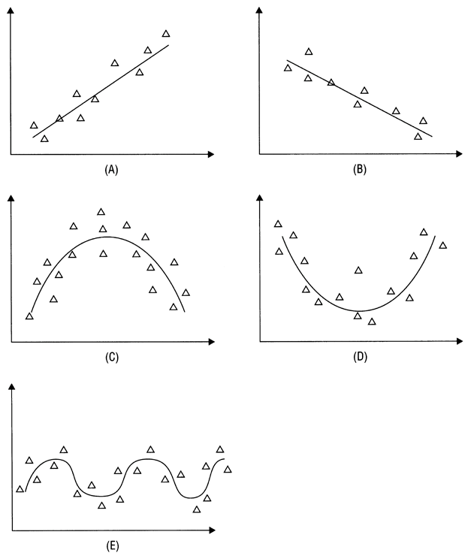
Key Experimental Design Concepts
Local control
Correlation: the most popular technique to assess relationships among observational data
Linear and nonlinear correlation.
Nonlinear correlation is hard to be measured and may stay hidden.

Slide 49
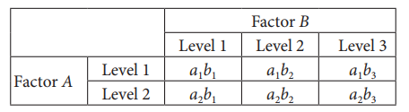
Formal Experiments: Types
An independent variable is called a factor in the experimental design.
Various values or classifications for each factor are called the levels of the factor.
Expressing the design in terms of factors, called the factorial design, tells you how many diﬀerent treatment combinations are required.
A study to determine the effect of experience and language on the productivity of programmers has two factors: experience and language. The dependent variable is productivity.
Notes:
Expressing the design in terms of factors, called the factorial design, tells you how many diﬀerent treatment combinations are required.

Slide 50
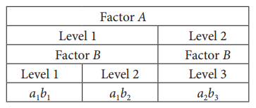
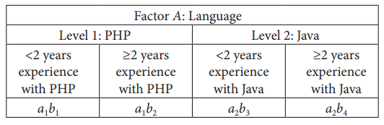
Formal Experiments: Types
Factorial design:
Crossing (each level of each factor appears with each level of the other factor)
Nesting (each level of one occurs entirely in conjunction with one level of another)
Proper nested or crossed design may reduce the number of cases to be tested.
A study to determine the effect of experience and language on the productivity of programmers has two factors: experience and language. The dependent variable is productivity.
Notes:
1. PHP programmers with less than 2 years of experience with PHP (a1b1) 2. PHP programmers with less than 2 years of experience with Java (a1b3) 3. PHP programmers with at least 2 years of experience with PHP (a1b2) 4. PHP programmers with at least 2 years of experience with Java (a1b4) 5. Java programmers with less than 2 years of experience with PHP (a2b1) 6. Java programmers with less than 2 years of experience with Java (a2b3) 7. Java programmers with at least 2 years of experience with PHP (a2b2) 8. Java programmers with at least 2 years of experience with Java (a2b4)

Slide 51
Formal Experiments: Types
Advantages of factorial design
Resources can be used more efficiently
Coverage (completeness) of the target variables’ range of variation
Disadvantages of factorial design
Higher costs of preparation, administration and analysis
Number of combinations will grow rapidly
Some of the combinations may be worthless

Slide 52
Experiments: Sister Projects
Suppose your organization is interested in modifying the way it performs code inspections.
To perform such a study, you select two projects, called sister projects, each of which is typical of the organization and has similar values for the state variables that you have planned to measure.
For instance, the projects may be similar in terms of application domain, implementation language, specification technique, and design method.

Slide 53
Experiments: Baselines
a baseline, also called a reference configuration.
It provides a measure to identify whether the value is within an acceptable range.
If you are unable to find two projects similar enough to be sister projects, you can compare your new inspection technique with a general baseline.
Baseline is an “average” treatment of a variable in a number of experiments
You collect different data from other projects, the data can include descriptive measures, such as product size, eﬀort expended, number of faults discovered, and so on. You will get an “average” situation that is typical in your company.

Slide 54
Experiments: Retrospective case studies
You can also conduct a case study involving portions of a system, by studying version histories and error logs.
Such retrospective case studies are limited to available data, and you have limited or no control of variables.
However, this allows you to study the evolution of systems over multiple versions and potentially over many years.

Slide 56
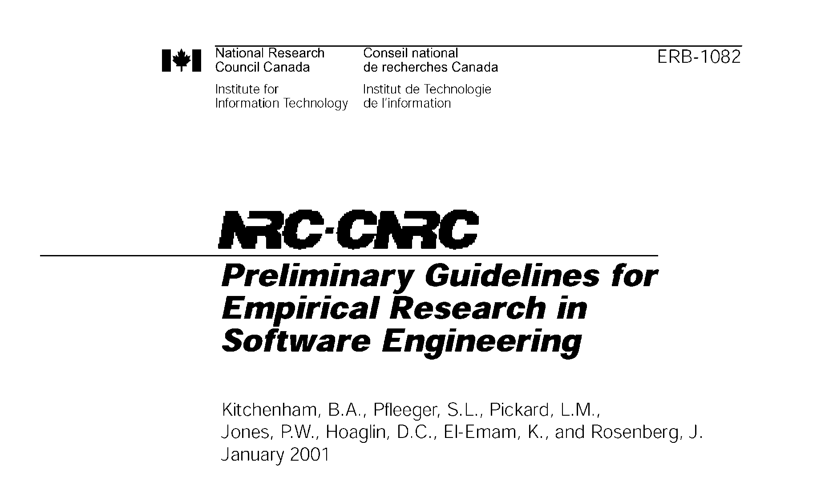
Empirical Research Guidelines

Slide 57
Contents
Experimental context
Experimental design
Data collection
Analysis
Presentation of results
Interpretation of results

Slide 58
1. Experimental Context
Goals:
Ensure that the objectives of the experiment have been properly defined
Ensure that the description of the experiment provides enough details for the practitioners
Checklists:
C1: Be sure to specify as much of the context as possible. In particular, clearly define the entities, attributes and measures that are capturing the contextual information.
C2: If a specific hypothesis is being tested, state it clearly prior to performing the study, and discuss the theory from which it is derived, so that its implications are apparent.
C3: If the target is exploratory, state clearly and, prior to data analysis, what questions the investigation is intended to address, and how it will address them.

Slide 59
2. Experimental Design
Goal:
Ensure that the design is appropriate for the objectives of the experiment
Ensure that the objective of the experiment can be reached using the techniques specified in the design
Checklists:
D1: Identify the population from which the subjects and objects are drawn.
D2: Define the process by which the subjects and objects were selected (inclusion/exclusion criteria).
D3: Define the process by which subjects and objects are assigned to treatments.
D4: Restrict yourself to simple study designs or, at least, to designs that are fully analyzed in the literature.
D5: Define the experimental unit.

Slide 60
2. Experimental Design
D6: For formal experiments, perform a pre- experiment or pre-calculation to identify or estimate the minimum required sample size.
D7: Use appropriate levels of blinding.
D8: Avoid the use of controls unless you are sure the control situation can be unambiguously defined.
D9: Fully define all treatments (interventions).
D10: Justify the choice of outcome measures in terms of their relevance to objectives of the empirical study.

Slide 61
3. Data Collection
Goal
Ensure that the data collection process is well defined
Monitor the data collection and watch for deviations from the experiment design
Checklists:
DC1: Define all software measures fully, including the entity, attribute, unit and counting rules.
DC2: Describe any quality control method used to ensure completeness and accuracy of data collection.
DC3: For observational studies and experiments, record data about subjects who drop out from the studies.
DC4: For observational studies and experiments, record data about other performance measures that may be adversely affected by the treatment, even if they are not the main focus of the study.

Slide 62
4. Analysis
Goal
Ensure that the collected data from the experiment is analyzed correctly
Monitor the data analysis and watch for deviations from the experiment design
Checklists:
A1: Specify any procedures used to control for multiple testing.
A2: Consider using blind analysis (avoid “fishing for results”).
A3: Perform sensitivity analysis.
A4: Ensure that the data do not violate the assumptions of the tests used on them.
A5: Apply appropriate quality control procedures to verify the results.

Slide 63
5. Presentation of Results
Goal
Ensure that the reader of the results can understand the objective, the process and the results of experiment
Checklists:
P1: Describe or cite a reference for all procedures used. Report or cite the statistical package used.
P2: Present quantitative results as well as significance levels. Quantitative results should show the magnitude of effects and the confidence limits.
P3: Present the raw data whenever possible. Otherwise, confirm that they are available for review by the reviewers and independent auditors.
P4: Provide appropriate descriptive statistics.
P5: Make appropriate use of graphics.

Slide 64
6. Interpretation of Results
Goal
Ensure that the conclusions are derived merely from the results of the experiment
Checklists:
I1: Define the population to which inferential statistics and predictive models apply.
I2: Differentiate between statistical significance and practical importance.
I3: Specify any limitations of the study.

Slide 65


